Slide 1
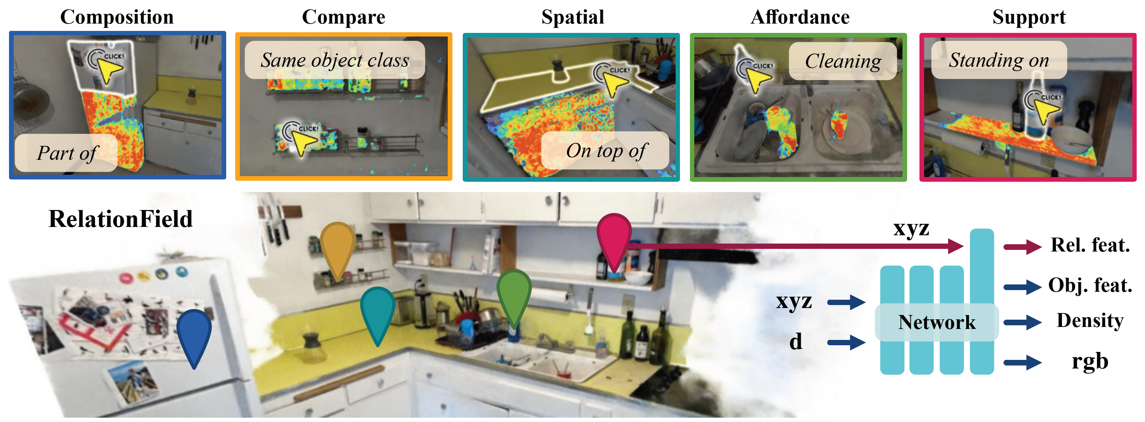






RelationField
Relate Anything in Radiance Fields
CVTS 2025
Sebastian Koch Johanna Wald Narunas Vaskevicius Mirco Colosi Pedro Hermosilla Federico Tombari Timo Ropinski

Slide 2
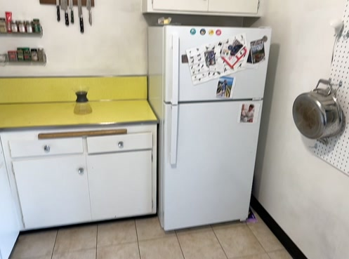
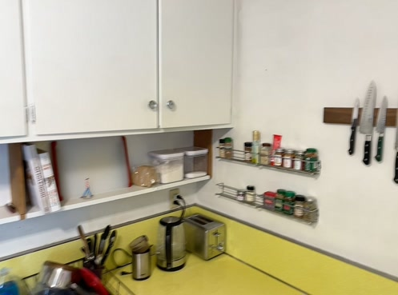
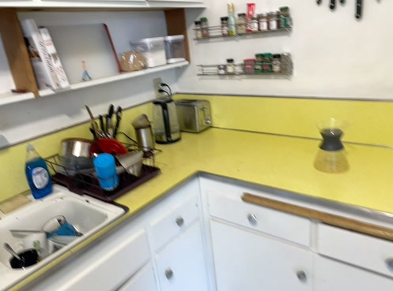

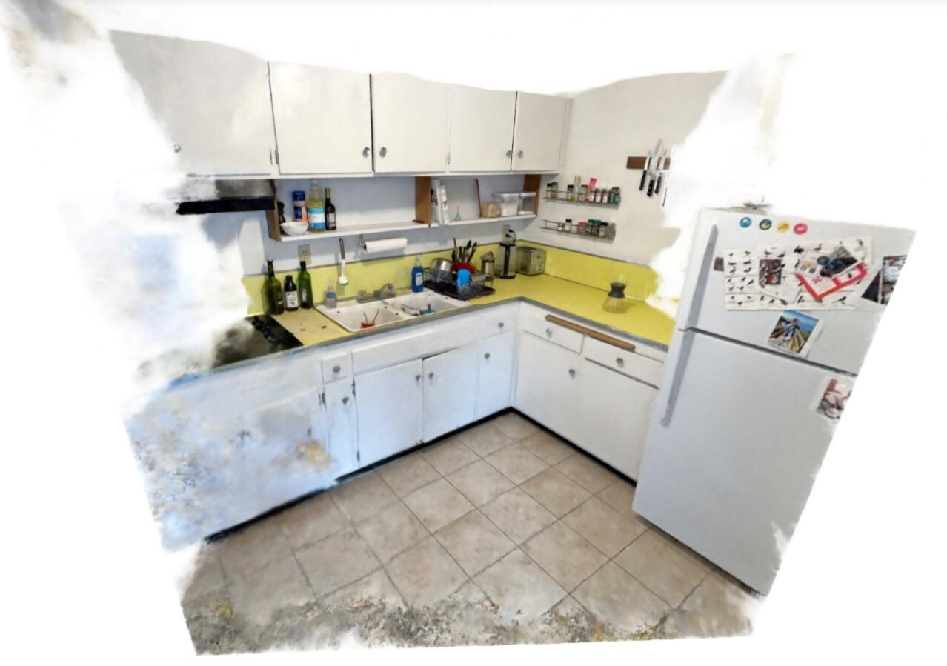
NeRF
Notes:
So lets look in detail into how a NeRF is build. A NeRF is a neural network that takes as input a xyz location together with a viewing direction of the camera to predict a density and rgb feature for the given input.
When we now execute this network for the entire scene and render its output onto a 2d image plane we get the novel view synthesis formulation known from NeRF.
Methods such as LERF now extent the NeRF formulation by proposing an additional output feature, that is supervised by a foundation model such as CLIP.
You can see here how in LeRF we can query different textutal labels encoded with CLIP, to get localisation outputs in the 2D rendered images or directly in 3D.
Here for instance for simple objects as the soap bottle or higher level concepts such as the color yellow
In RelationField we extend this NeRF formulation even further, by propsing an additional language output as in LERF for the relationship feature.
But furthermore, we introduce a secondary xyz position as input which is used to condition the relationship output.
We do this because we identified, that unlike for objects, for relationships, you always need a reference point, that anchors your relationship.
For instance, we treat the bottle here as our reference and then can query different relationships such as standing on.
But this does of course work for all sorts of relationships such as composition, compare, spatial, affordance and support relationships.

Slide 3
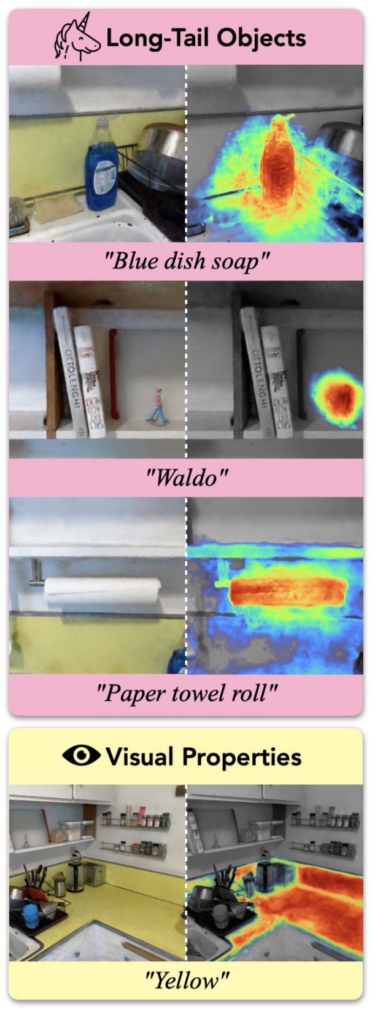
NeRF + Object Semantics
Soap
Yellow
LERF/OpenNeRF
[1] Kerr et al.: LERF: Language Embedded Radiance Fields, ICCV’2023
Notes:
So lets look in detail into how a NeRF is build. A NeRF is a neural network that takes as input a xyz location together with a viewing direction of the camera to predict a density and rgb feature for the given input.
When we now execute this network for the entire scene and render its output onto a 2d image plane we get the novel view synthesis formulation known from NeRF.
Methods such as LERF now extent the NeRF formulation by proposing an additional output feature, that is supervised by a foundation model such as CLIP.
You can see here how in LeRF we can query different textutal labels encoded with CLIP, to get localisation outputs in the 2D rendered images or directly in 3D.
Here for instance for simple objects as the soap bottle or higher level concepts such as the color yellow
In RelationField we extend this NeRF formulation even further, by propsing an additional language output as in LERF for the relationship feature.
But furthermore, we introduce a secondary xyz position as input which is used to condition the relationship output.
We do this because we identified, that unlike for objects, for relationships, you always need a reference point, that anchors your relationship.
For instance, we treat the bottle here as our reference and then can query different relationships such as standing on.
But this does of course work for all sorts of relationships such as composition, compare, spatial, affordance and support relationships.

Slide 4
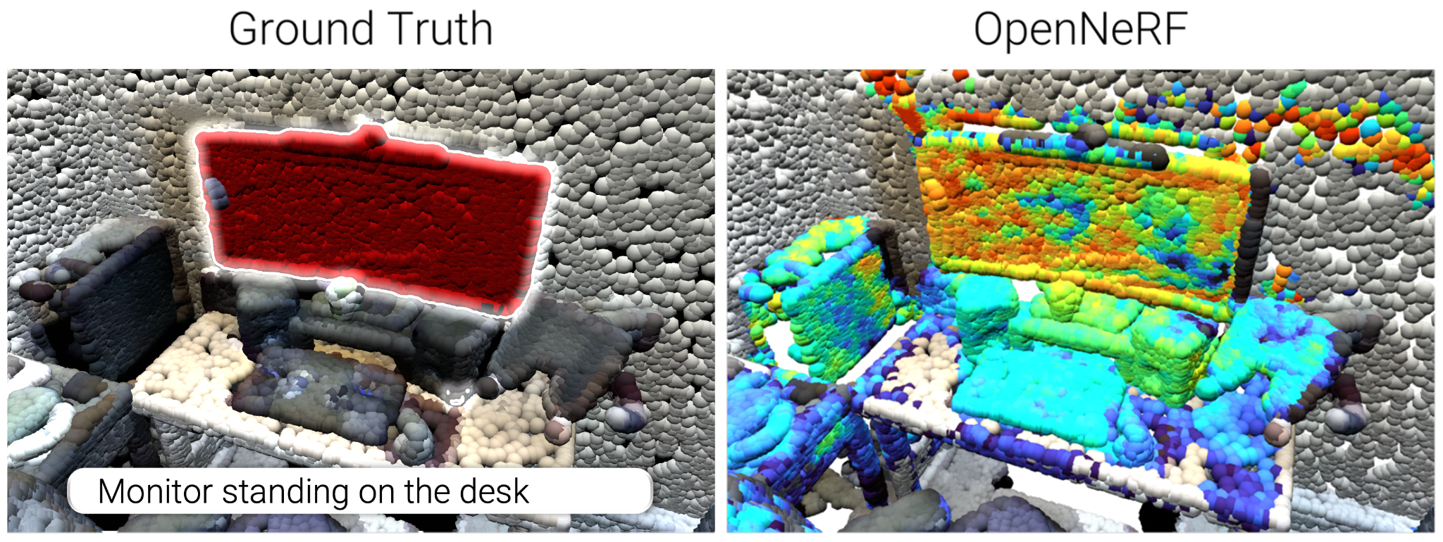
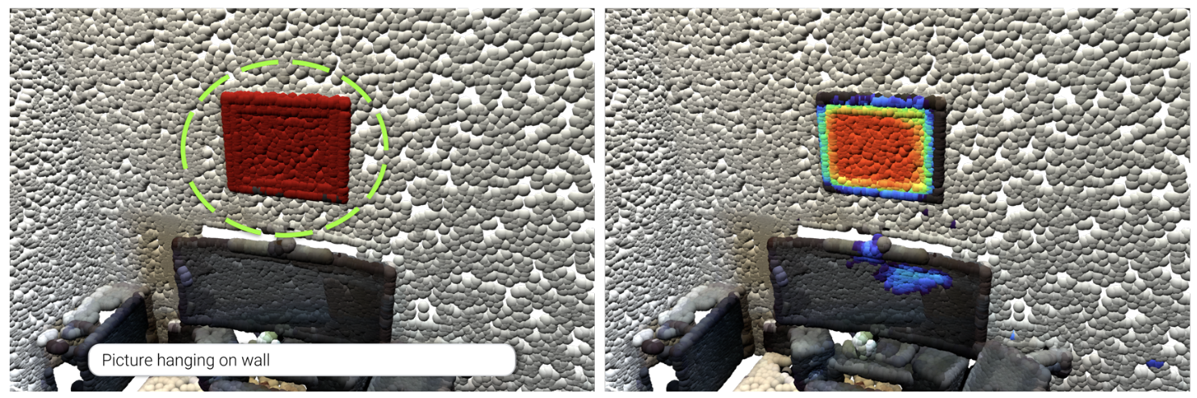
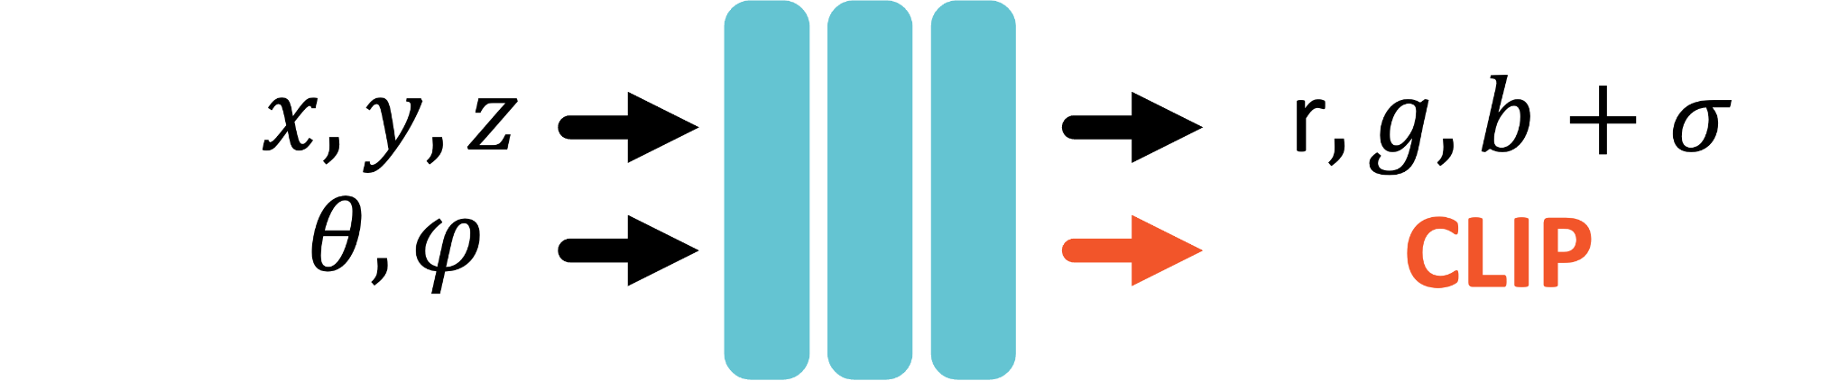


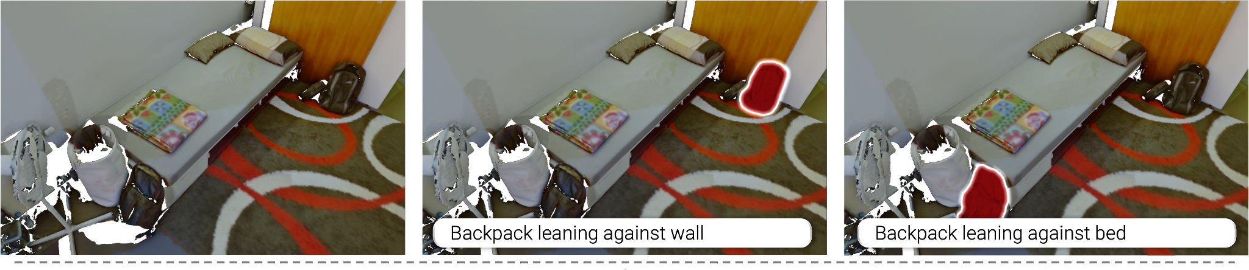

Localizing objects in 3D scenes
Existing approaches extend NeRF/3DGS with CLIP features for open-vocabulary reasoning in 3D
To identify duplicate objects; relationship descriptions are needed!
☹️ CLIP-based approaches struggle with complex relationship queries
💡 Model 3D relationships explicitly for improved understanding of complex queries
Notes:
In recent years, radiance field approaches such as NeRF or Gaussian Splatting have been combined with 2D foundation modeles such as DINO, CLIP, SAM or Stable Diffusion to form so called "Feature Fields".
These feature fields can be used to perform tasks such as Open-Vocabulary Object Localisation or Interactive Instance Segmentation.
While NeRF was originally proposed for novel-view synthesis, it is ideal to lift 2d foundation model knowledge to 3D, as NeRF directly models the underlying 3D geometry, but is exclusievly supervised by 2d images which can be used to extract foundation model features.
However, existing works mainly focus on object centric representations and completely ignore relationships and object interactions

Slide 5
RelationField: NeRF + Relationship Semantics
Soap
Yellow
Notes:
So lets look in detail into how a NeRF is build. A NeRF is a neural network that takes as input a xyz location together with a viewing direction of the camera to predict a density and rgb feature for the given input.
When we now execute this network for the entire scene and render its output onto a 2d image plane we get the novel view synthesis formulation known from NeRF.
Methods such as LERF now extent the NeRF formulation by proposing an additional output feature, that is supervised by a foundation model such as CLIP.
You can see here how in LeRF we can query different textutal labels encoded with CLIP, to get localisation outputs in the 2D rendered images or directly in 3D.
Here for instance for simple objects as the soap bottle or higher level concepts such as the color yellow
In RelationField we extend this NeRF formulation even further, by propsing an additional language output as in LERF for the relationship feature.
But furthermore, we introduce a secondary xyz position as input which is used to condition the relationship output.
We do this because we identified, that unlike for objects, for relationships, you always need a reference point, that anchors your relationship.
For instance, we treat the bottle here as our reference and then can query different relationships such as standing on.
But this does of course work for all sorts of relationships such as composition, compare, spatial, affordance and support relationships.

Slide 6
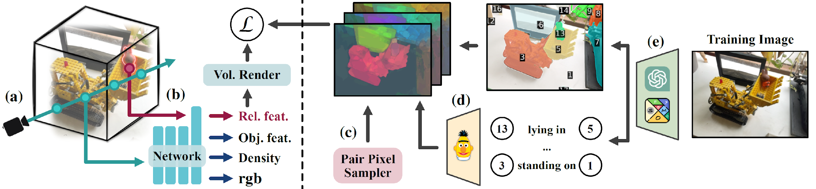
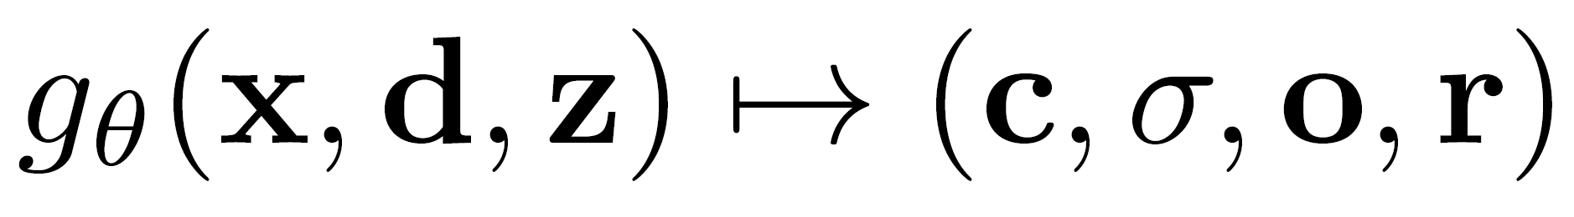
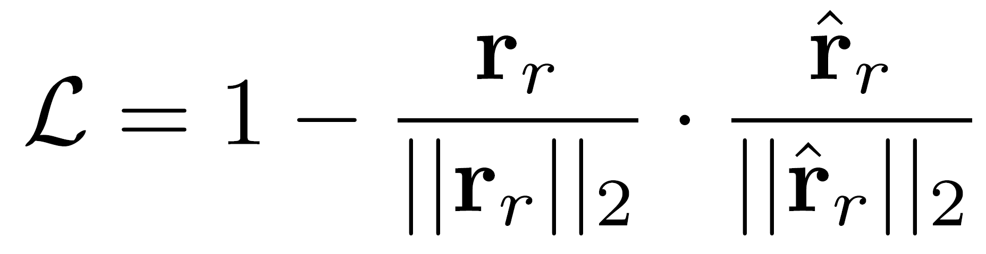
RelationField Training
Radiance field equation:
BERT embedding for feature supervision and concept generalization
GPT-4o + SoM for mask-aligned relationship captions
50 – 200 training images per scene
Loss function:
Notes:
To train RelationField, we generally follow general NeRF practice, we shoot a ray into 3d space from our camera, but now with an additional xyz for the relationship query.
The neural network then outputs rgb, density, obj feat, rel feat for the given ray and we render this to the image plane for supervision.
For supervision we need between 50 to 200 images given the size and complexity of the scene.
We then encode each image with a foundation model, here chatgpt together with an advanced visual prompting strategy, which overlays autogenerated masks on top of the image together with these numbered tags, such that it is easier for models such as chatgpt to reference objects and their relationships.
The output of chatgpt are textual captions of the relationships together with the tags for the objects. But we cannot use the captions directly, we need to encode them to a high dimension space, with a language encoder such as bert and place them in the referenced masks.
Each image then generates multiple of these relationship feature maps, as each encodes a single relationship between objects. Then we use a pair pixel sampler, to efficiently select pixel pairs, that contain embeddings of object relationships for supervising the ray output coming from our NeRF.
The training loss is a simple cosine similarity loss for feature distillation.

Slide 7
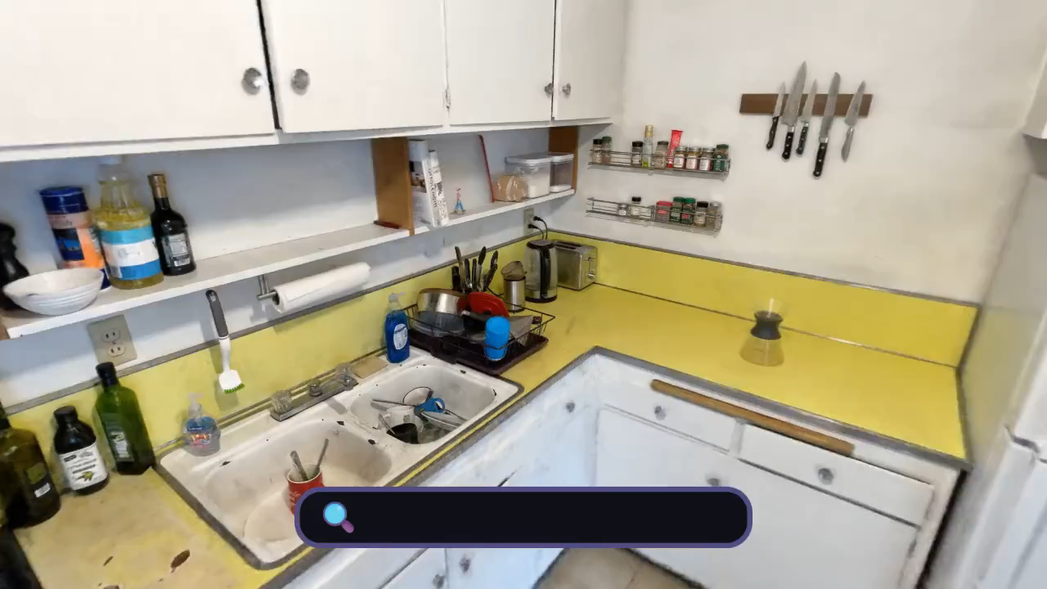
RelationField Demo
Notes:
Here is a live demo of Relationfield.

Slide 8
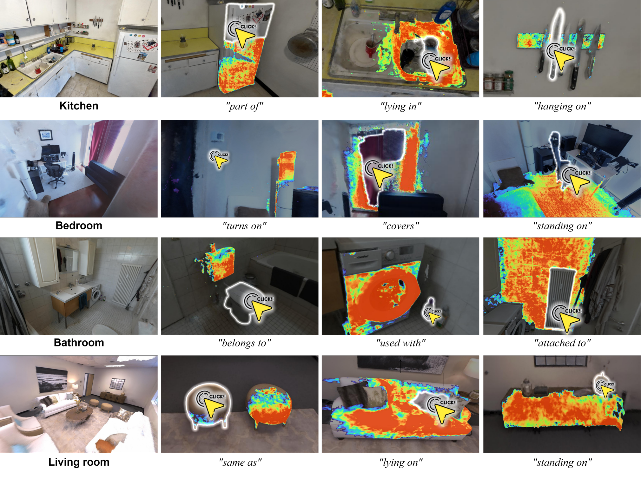
Extracting Relationships through “Clicks”
Interactive Relationship Extraction
🤓☝️ Clicks can be selected interactively or sampled automatically
Notes:
But Relationfield not only works on one particular scene type.
Without needing to change the training pipeline at all we can run relationfield on different scenes such as kitchens, bedrooms, bathrooms and living rooms.
One thing I want to highlight are these functual relationships.
Here we select the light switch and query turns on and relationfield actually highlights the light.
THis is of course very useful for a robot agent that is tasked to turn on the light and needs to now that it has to interact with the light switch rather then the light itself.

Slide 9
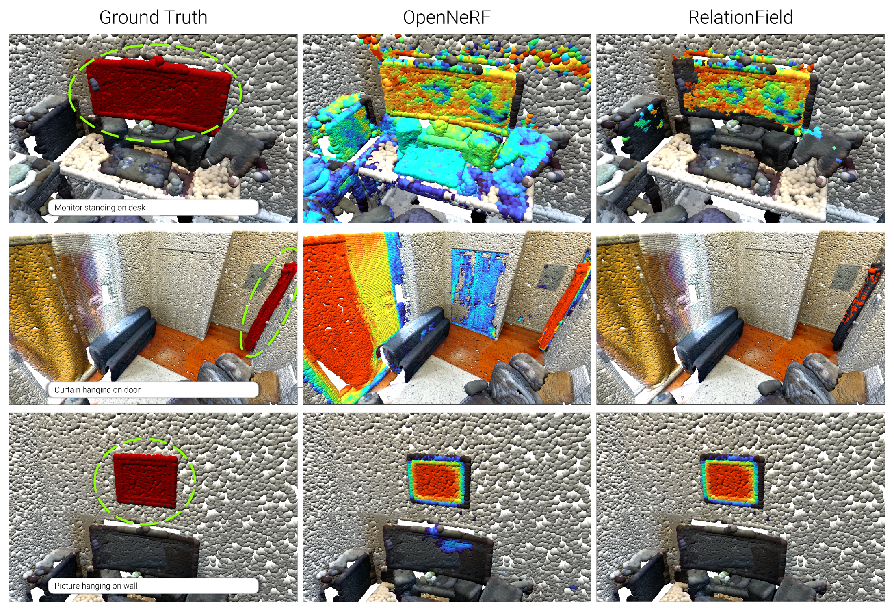
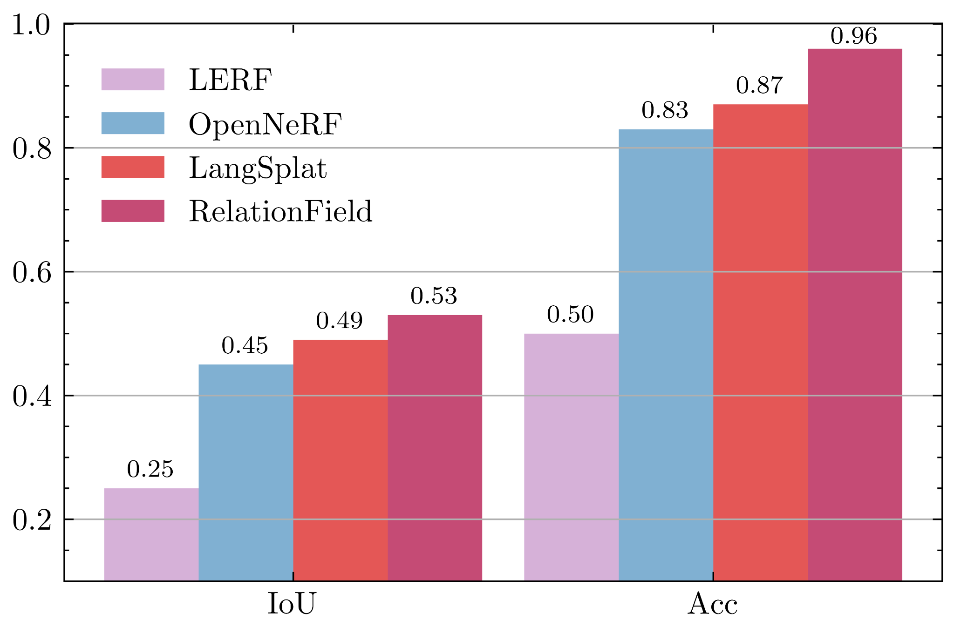
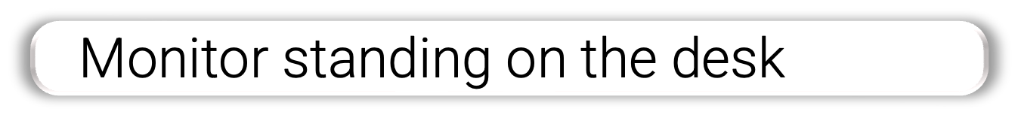
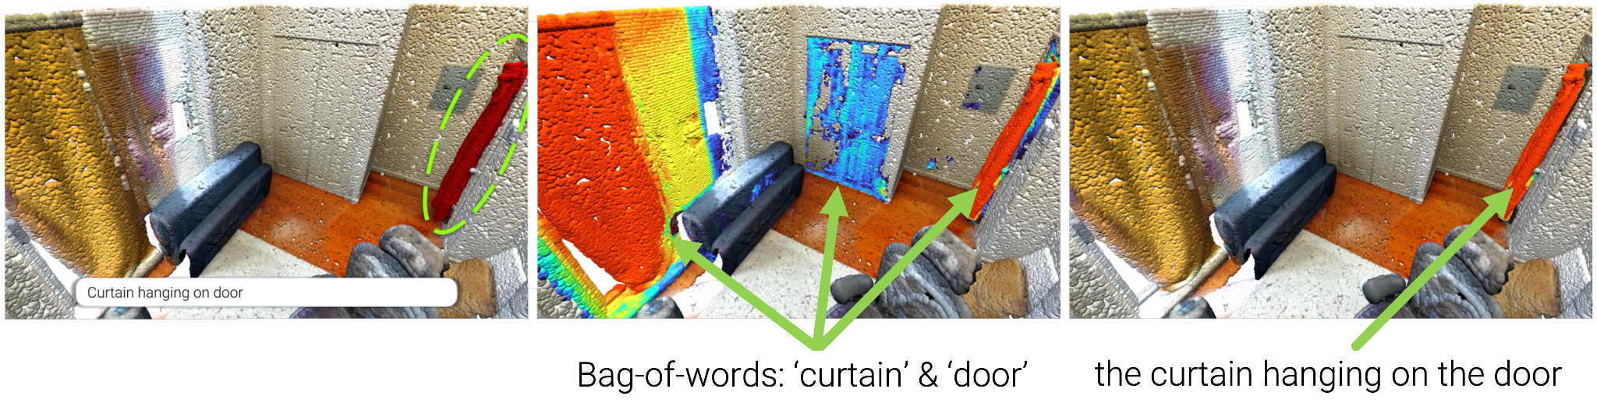
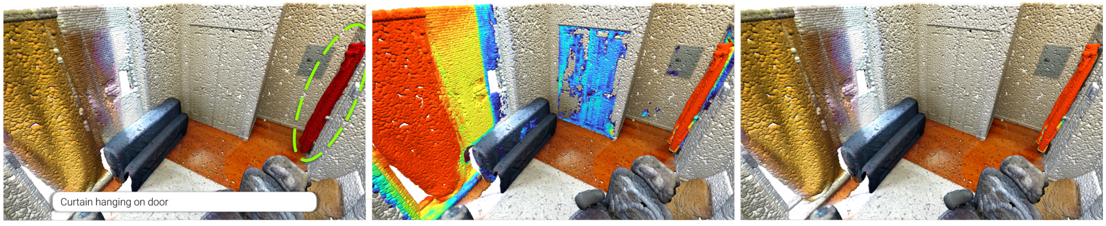
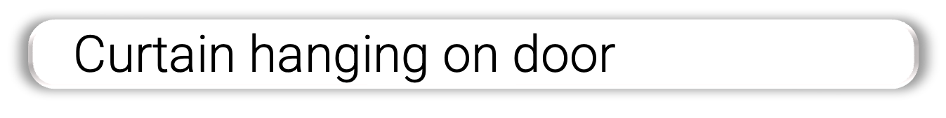
Open-Vocabulary Instance Localization
Improved open-vocabulary instance localization for complex queries!
Object semantics + relationship understanding = a
Improved understanding of complex queries
Notes:
We observe that compared to the corrent SOTA such as OPenNerf or Langsplat, our method outperforms them all and is the only method, that does not get confused by complex queries like here the monitor standing on the desk or the curtain hanging on the door which OpenNerf confuses with the curtain in front of the window.

Slide 10
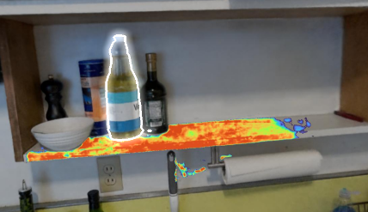
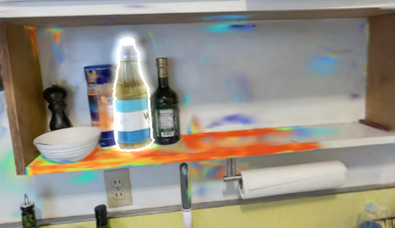

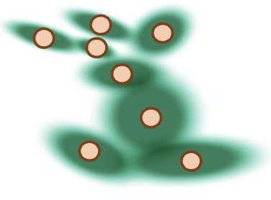
RelationField: NeRF vs Gaussian Splatting
RelationField (NeRF)
RelationField (3DGS)
Trained 3DSG
xyz
Trained RelationField
Geometry & Feature Field trained jointly
1.3x more memory
Geometry & Feature Field trained separately
4x speed-up
1.7
7.1
20
27
🤓☝️ RelationField with 3DGS achieves higher rendering speed at the cost of memory consumption & quality
Notes:
Now I have shown that RelationFIeld works great based on Nerf, however the community largely has moved to gaussian splatting because of the potential speed benefits.
So can RelationField also be applied with gaussian splatting.
Yes, however different to the NeRF variant where we optimize geometry and semantic features simultaneously, with the gaussian splatting varient, we optimize them after the other to save GPU memory.
Once a Gaussian Splatting Field is trained we can learn a small relationfield head that outputs the relationfield feature for a pair of gaussians in the scene.
We achieve around a 4x speed up with Guassian splatting, however memory requirments increases.
THe quality of relationfield with Nerf and 3dgs is comparable but is slightly better using nerf because of the joint geometry and semantic optimization

Slide 11
Take aways
🥳 RelationField enables 3D relationship reasoning from 2D observations.
🥳 Inter-object relationships are defined as ray pairs, capturing spatial and semantic interactions between objects.
🥳 RelationField encodes powerful foundation model knowledge, making relationships queryable in near real-time.
Notes:
To summerize, RelationField en

Slide 12
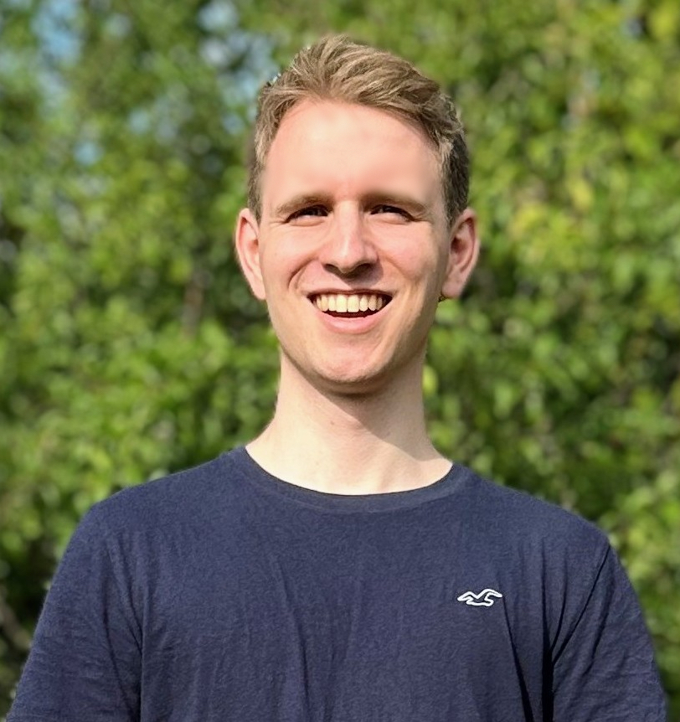

RelationField
Relate Anything in Radiance Fields
Sebastian Koch Johanna Wald Narunas Vaskevicius Mirco Colosi Pedro Hermosilla Federico Tombari Timo Ropinski
Paper, code, and demo: relationfield.github.io/
kochsebastian.github.io

Slide 13
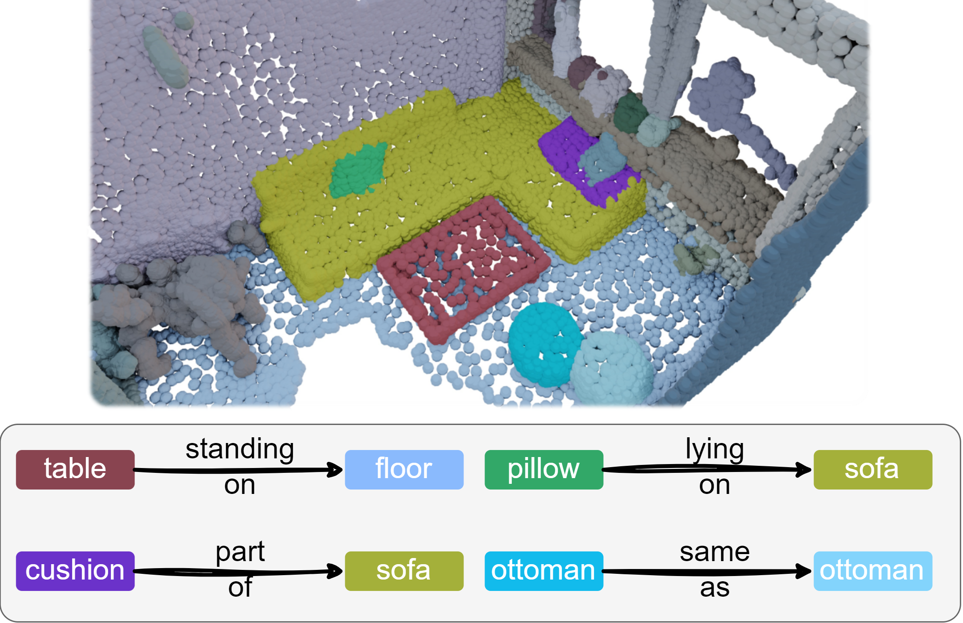

Application: 3D Scene Graph Prediction
3D Scene Graph Extraction
Interactive Relationship Extraction
Object Semantics + Relationship Semantics = 3D Scene Graph
Automatic Clicks
(only 2D renders)
Notes:
By combining the relationship reasoning and object semantics we can also extract 3d scene graphs from relationfield to compare to more classical methods and output it true hollistic 3d scene representation

Slide 14
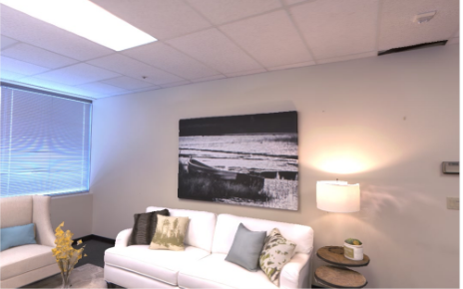
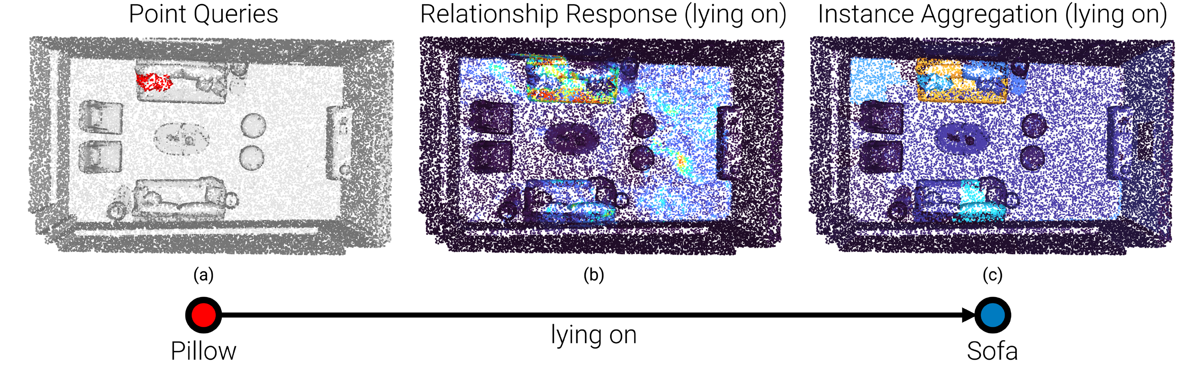
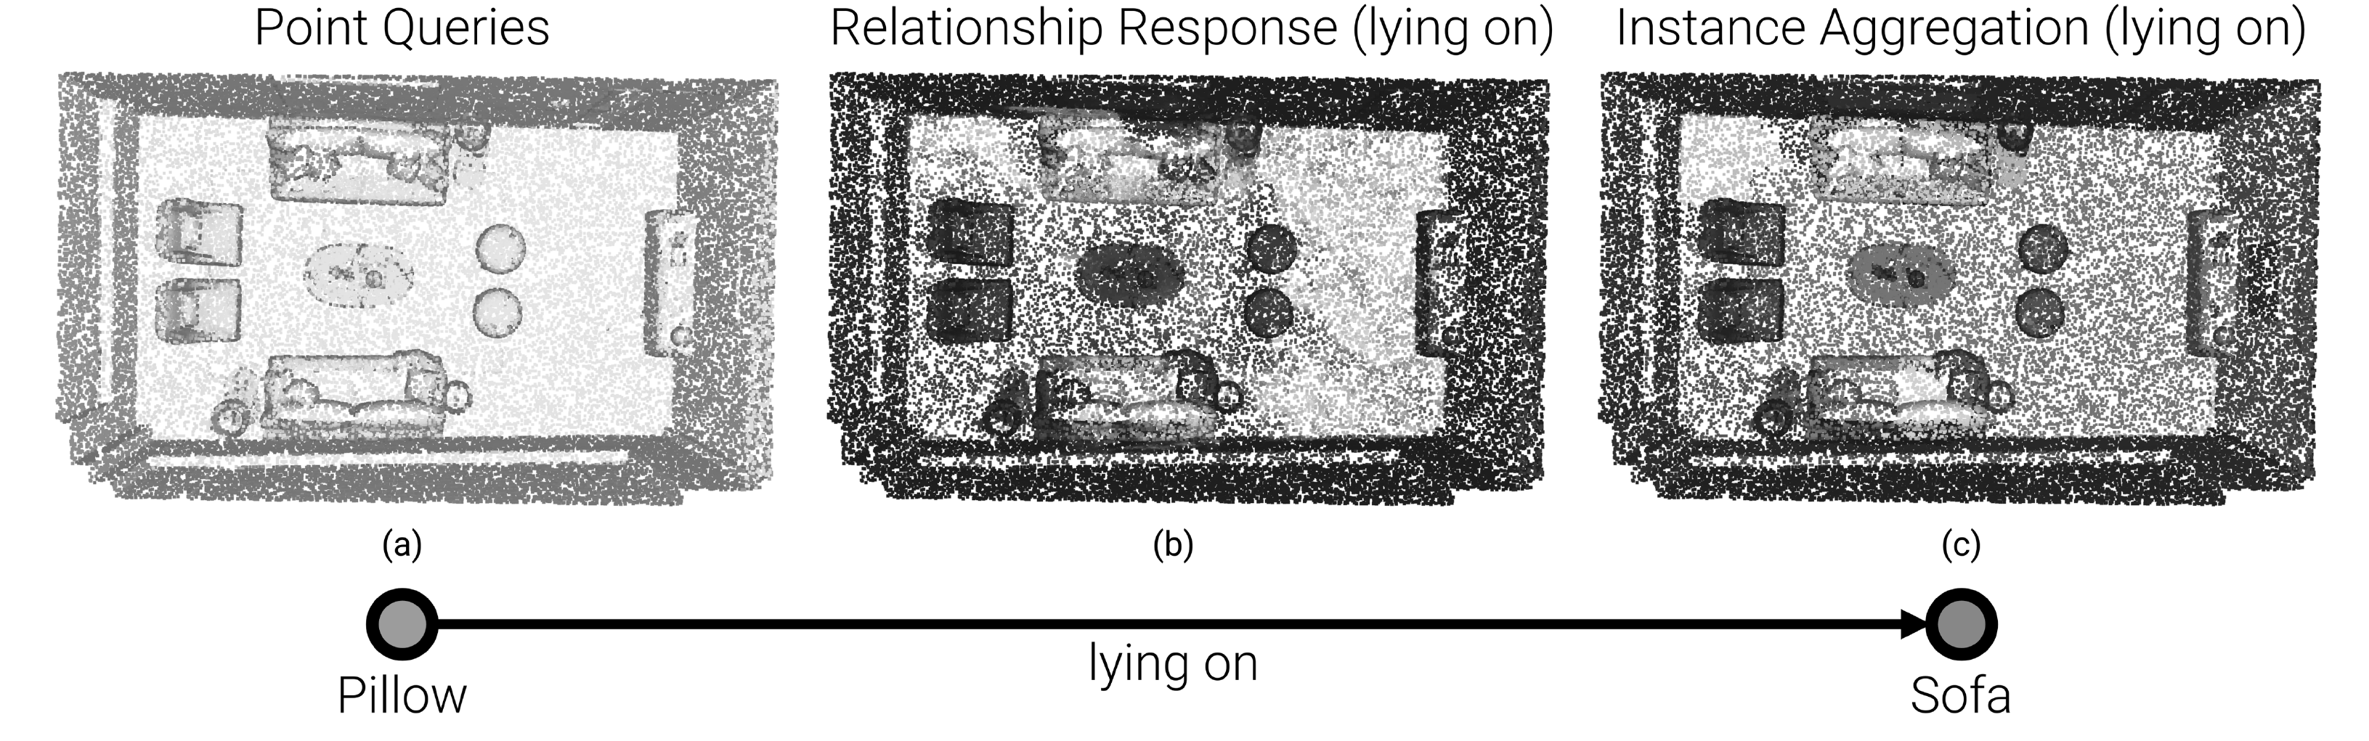
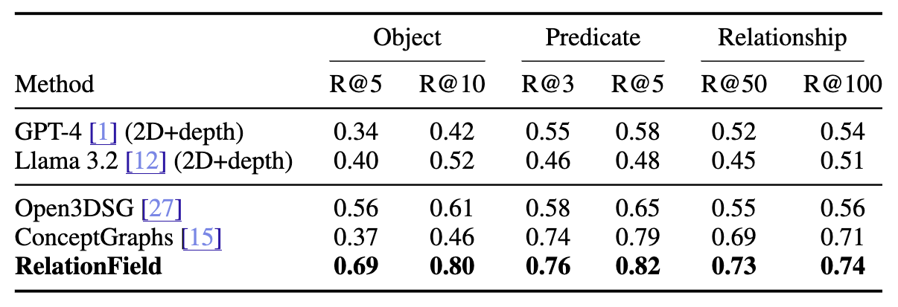
3D Scene Graph Construction
RelationField
xyz
d
Image
PCL
Steps:
0a. Fetch or compute point cloud from NeRF
0b. Instance Segmentation using Object feature
Select query object
Compute Relationship feature for complete point cloud
Aggregate embeddings onto instances
🥳 SOTA OV 3D Sene Graph Prediction!
Notes:
We do this by running relationfield slightly differently.
First of all we dont care about the view direction and also dont need to output a rgb feature for image rendering when we want to output a 3d scene graph.
Then we can compute a 3d reconstruction of the scene from the density of the nerf and use the object feature for segmenting individual objects in the point cloud.
Then in a fully automatic process, we can treat different object instances as initial nodes in the scene graph and relationship queries for relationfield
We can then compute the relationship activation for each instance using the rest of the point cloud. to get the edge class in the scene graph
and finally we can aggregate the activations onto the instances in the point cloud to get the other node in the scene graph ede.
THis can be repeated for all no. des with different relationship queries in a completly automatic manner to extract the complete scene graph
using this process we achieve SOTA 3d scene graph prediction performance!

Slide 15
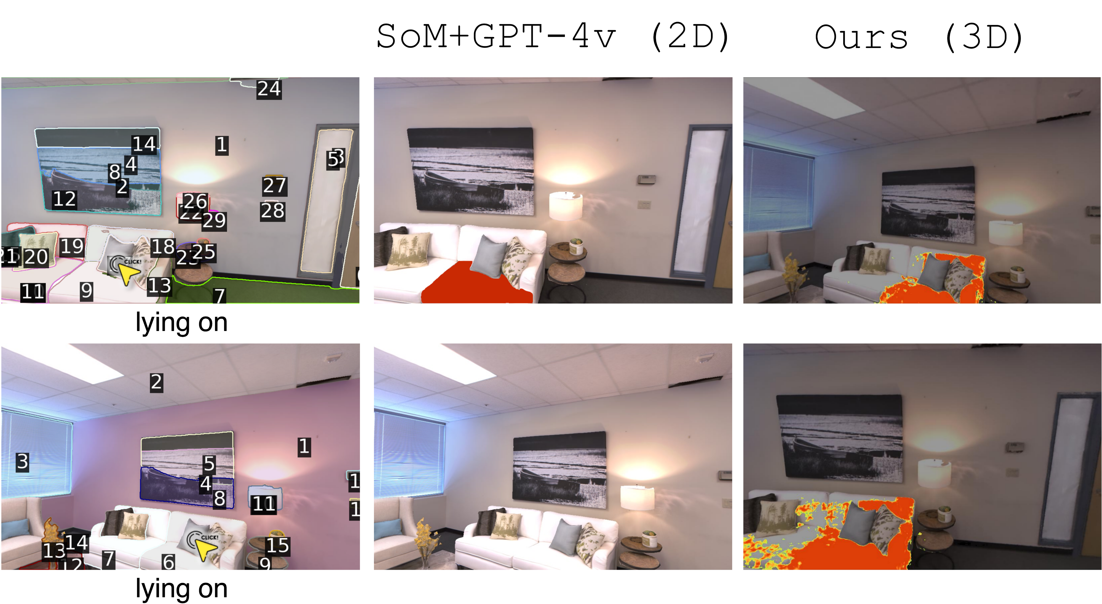
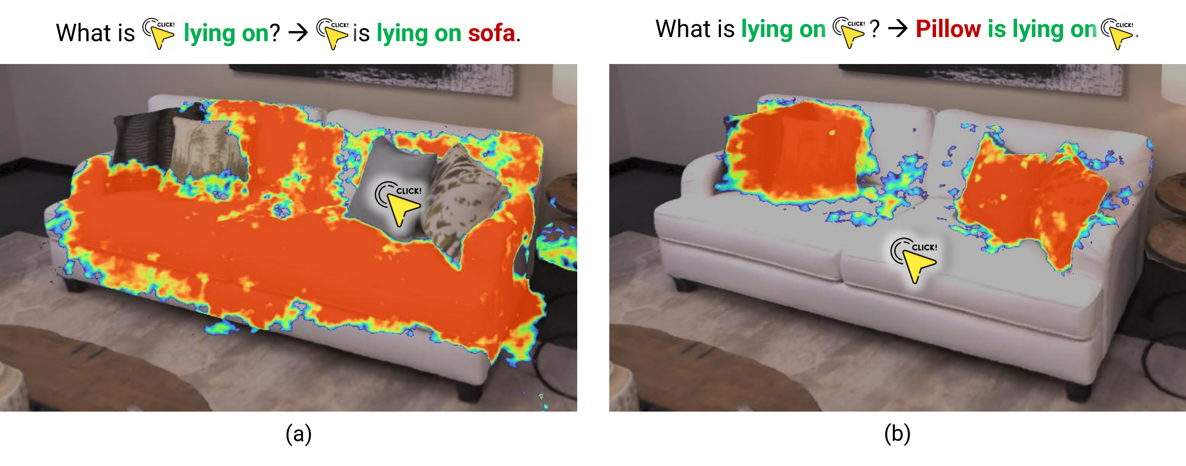
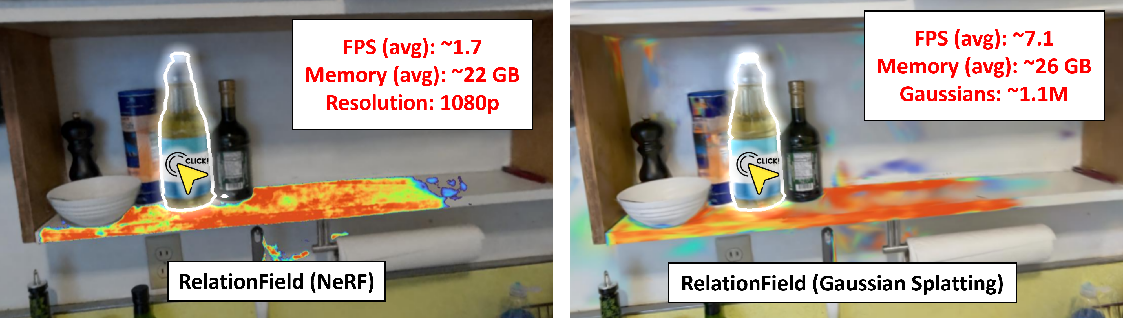
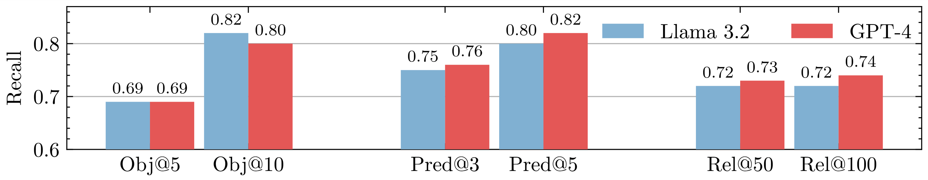
RelationField Ablations
Does RelationField learn 3D consistent knowledge?
Does the relationship direction matter?
NeRF vs 3DGS
Does the foundation model matter?

Slide 16
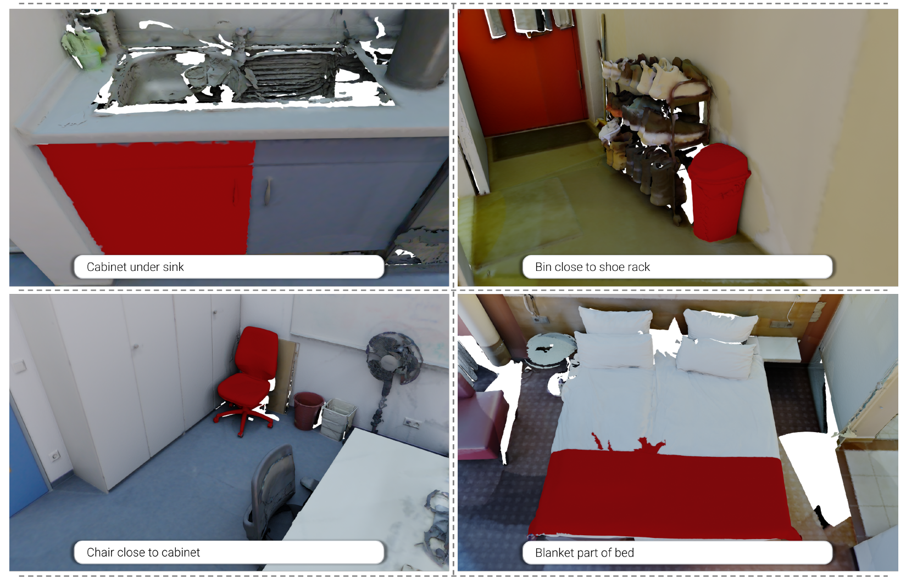
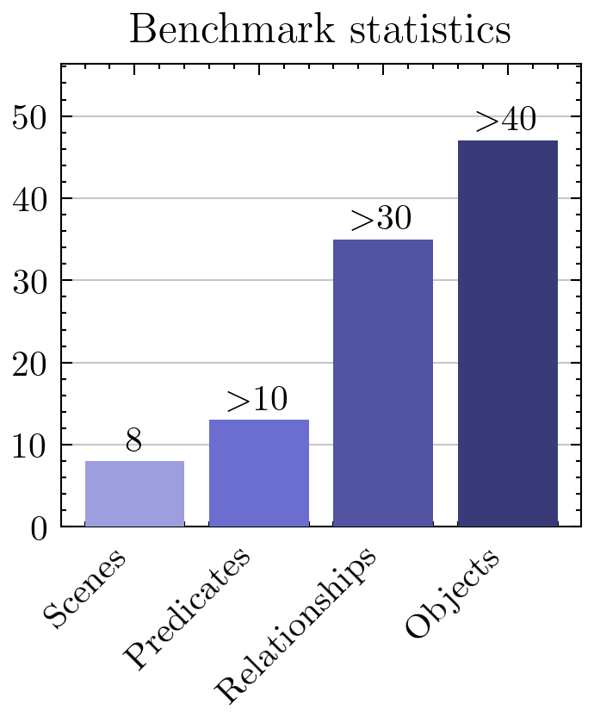
Benchmark
Complex Open-Vocabulary Instance Segmentation (new benchmark)
Notes:
To evaluate relationfield with other object centric radiance field approaches, we also propose a new benchmark with the focus on complex relationship oriented quries.
We labeled 8 scannet++ scene with over 30 unique relationships and more duplicates.
The focus of this dataset is to test really whether a method follows the query instruction or simply recognezies the objects in the queriy therefore for most queries there are multiple objects that are of the same object type as the searched object but only one has the correct relationship with its sourrounding such as the here here which you know fro m the very beginning.

Slide 17
Take aways
🥳 RelationField enables 3D relationship reasoning from 2D observations.
🥳 Inter-object relationships are defined as ray pairs, capturing spatial and semantic interactions between objects.
🥳 RelationField encodes powerful foundation model knowledge, making relationships queryable in near real-time.
🥳 RelationField models complex and causal relationships, enabling diverse downstream applications.
Notes:
To summerize, RelationField en

Slide 18
3D Relationship Reasoning
Interactive Relationship Extraction
Hollistic 3D Scene Understanding
Object Semantics + Relationship Semantics = 3D Scene Graph
Notes:
By combining the relationship reasoning and object semantics we can also extract 3d scene graphs from relationfield to compare to more classical methods and output it true hollistic 3d scene representation

Slide 19
3D Relationship Reasoning
Interactive Relationship Extraction
Notes:
But Relationfield not only works on one particular scene type.
Without needing to change the training pipeline at all we can run relationfield on different scenes such as kitchens, bedrooms, bathrooms and living rooms.
One thing I want to highlight are these functual relationships.
Here we select the light switch and query turns on and relationfield actually highlights the light.
THis is of course very useful for a robot agent that is tasked to turn on the light and needs to now that it has to interact with the light switch rather then the light itself.

Slide 20
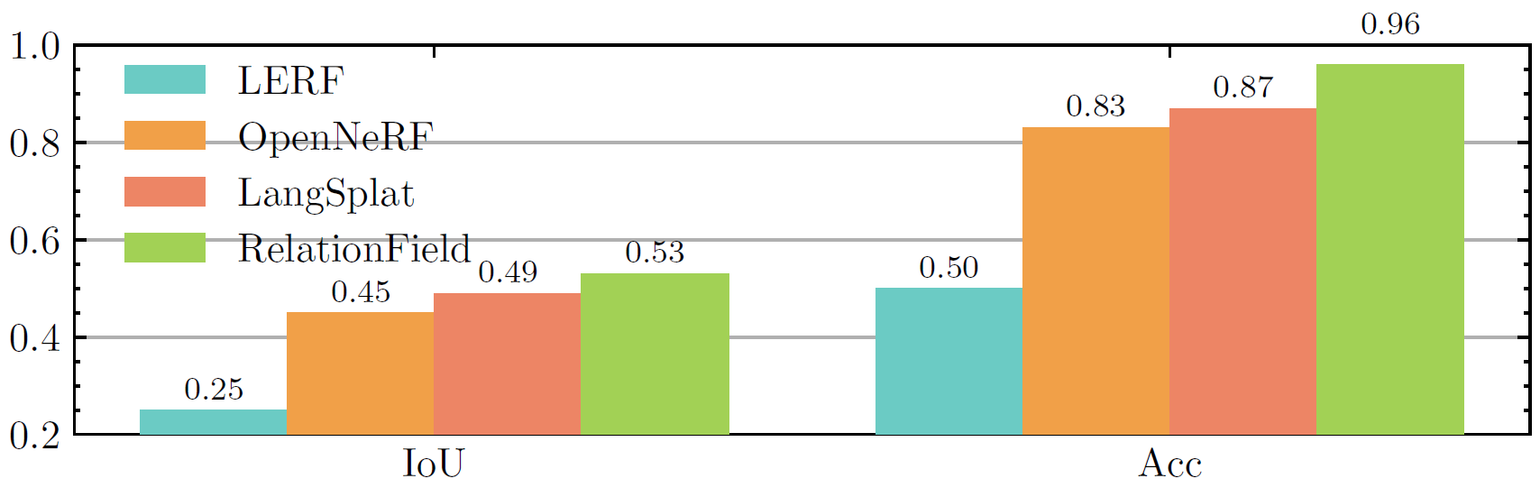
3D Relationship Reasoning
Understanding Relationships is very important and fills a gap in current 3D Scene Understanding models!
Complex Open-Vocabulary Instance Segmentation (new benchmark)
Notes:
We observe that compared to the corrent SOTA such as OPenNerf or Langsplat, our method outperforms them all and is the only method, that does not get confused by complex queries like here the monitor standing on the desk or the curtain hanging on the door which OpenNerf confuses with the curtain in front of the window.

